Slide 1
Competition of Social Opinions on Two-Layer Networks
Student : Cho Hyunchel
Supervisor : Wang Lin
2020. 2.17.
Notes:
Good morning, everyone.
I am Cho from Korea
I will present my thesis topic, “Competition of social opinions on two-layer networks.” In this thesis, I have researched a competition model of social network.
And I tried to obtain the features of a competition model by changing simulation conditions.

Slide 2
Contents
1
Background
2
Research Direction
3
A Two-layer Network Model
4
Simulation Results
5
Summary
6
Discussion and Future work
Notes:
The Contents order is like this. Background, Research Direction, A two-layer network model, Simulation results, summary, and discussion and future work.

Slide 3
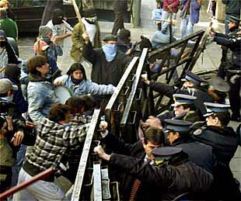

Background
Social conflict
- Different groups usually have different opinions
- Social conflicts are recognized as the competition on an interconnected network.
- The competition on an interconnected network has always been a hot topic.
- In this thesis, the competition between opinion formation group and decision-making
formation group is researched
Notes:
Background
Different groups usually have different opinions. This case can cause social competition or conflicts such as votes on social issues, presidential campaigns, and so on.
Social conflicts are recognized as the competition on an interconnected network.
The competition on an interconnected network has always been a hot topic in the field of complex networks and social behavior.
In this thesis, we investigate the competition between opinion formation group and decision-making formation group.

Slide 4
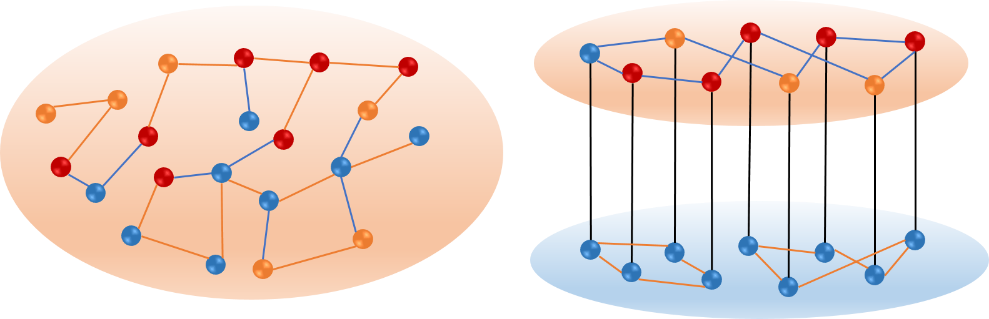
Background
Many previous researches have focused on studying the interaction on an isolated network.
However, real-world systems are not isolated, and they interact with other layers.
Single layer network | Interconnected network(Two-layer network)
1 dynamics | 2 dynamics (each layer has it dynamics)
1 parameter | 2 parameters
Internal edges | Internal edges + external edges
An interconnected network interaction is more complex than a single-layer network interaction.
Notes:
Many previous researches have focused on studying the interaction on a single layer network.
However, many real-world systems are not isolated, and they interact with other layers.
Comparing with a single layer network, an interconnected network has 2 dynamics, 2 parameters and includes internal edges and external edges.
Therefore, an interconnected network interaction is more complex than a single-layer network interaction.

Slide 5
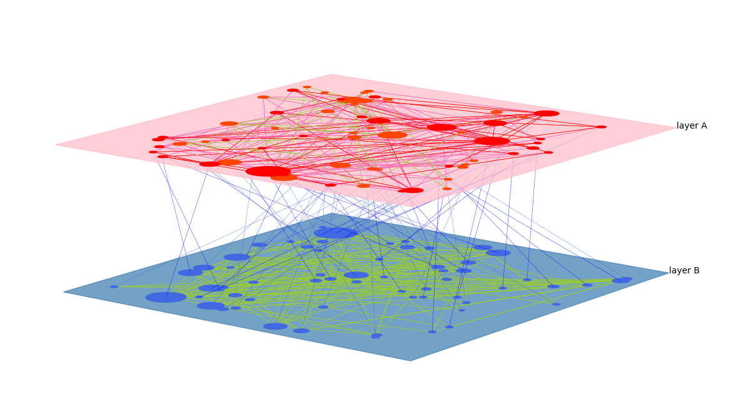
Research Direction
How is the network composed?
(Structure)
How does the interaction
of network work?
(Updating rule)
Which nodes are critical for changing the state?(Key nodes)
* These factors can influence the final state of a network.
Notes:
Next, Research Direction.
Considering a two-layer network like this figure, we can think these three questions.
First, How is the network composed? It is about network structures.
Second, How does the interaction of network work? It is about updating rule.
Third, Which nodes are critical for changing the state of a network? It is about key nodes.
These three factors can influence the final state.
Therefore, we carry out the various simulations by changing these three factors.

Slide 6
Research Direction
Objectives
- Study on the characteristics of competition models
Research Direction
- By changing network structures, it is analyzed what components make consensus.
- By changing updating rules, it is analyzed whether the updating rules affect the
final state of a network.
- By selecting key nodes, it is researched which nodes are critical and which method
has an excellent performance for identifying key nodes
Notes:
Thesis objectives is studying on the characteristics of competition models.
Research direction follows like this.
First, by changing network structures, it is studied what components make consensus.
Second, by changing updating rules, it is analyzed whether the updating rules affect the final state.
Third, by selecting key nodes, it is researched which nodes are critical and which method has an excellent performance for identifying key nodes.

Slide 7
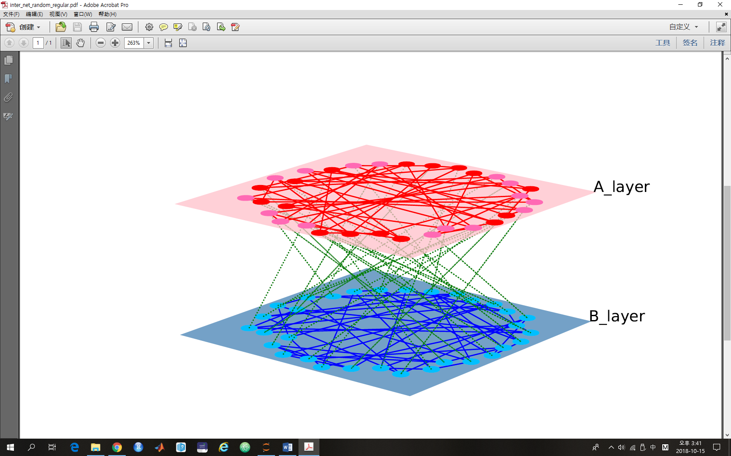
A Two-layer Network Model
Social opinion
Mutual interaction
Decision-making
Example case : legalization, vote systems, decision-making system
We study the competitions on interconnected networks with various structures, and investigate which structure and which updating rule have more probability to perform consensus results, and which key nodes are critical.
Notes:
A two-layer network model
This figure is a simple example for competition models. Layer A is a social opinion layer that consists of positive states. And layer B is a decision-making layer that consists of negative states.
They have mutual interaction each other. In the real world, we can apply for legalization, vote system and decision making system.
Here, we study the competitions on interconnected networks with various structures, and investigate which structure and which updating rule have more probability to perform consensus result, and which key nodes are critical.

Slide 8
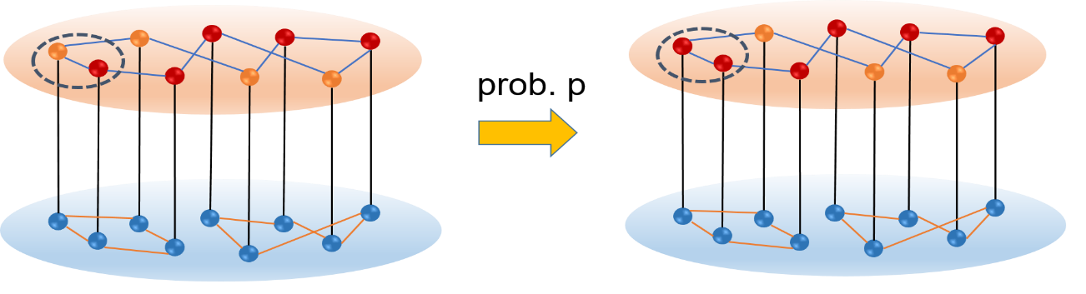

A Two-layer Network Model
Dynamics Algorithm for layer A
M-Model(including persuasion and compromise process in various opinion formation)
persuasion(probability p) : same orientation, increasing intensity
compromise(probability q) : opposite orientation, decreasing intensity
In this thesis, this model can have four states(-2, -1, +1, +2). The parameters are set up to be like p + q = 1. So, As the parameter of layer A, p represents the reinforcement
* reinforcement(p) : the tendency to keep orientation
Notes:
Next, I will provide the dynamics for each layer.
Dynamics Algorithm for layer A is like this.
We use M-model. M-model includes persuasion and compromise process in the opinion formation. This model can have various states. And the states are changed by probability p and probability q.
Probability p is for persuasion. That means the states become more extreme by probability p.
Probability q is for compromise. That means the states become more moderate or they are changed into the opposite state by probability q.
In this thesis, the model can have four states. And there are two parameters, p and q.
To represent the probability p and probability q together simply; we set p + q = 1.
So, p represents the strength of opinion.

Slide 9
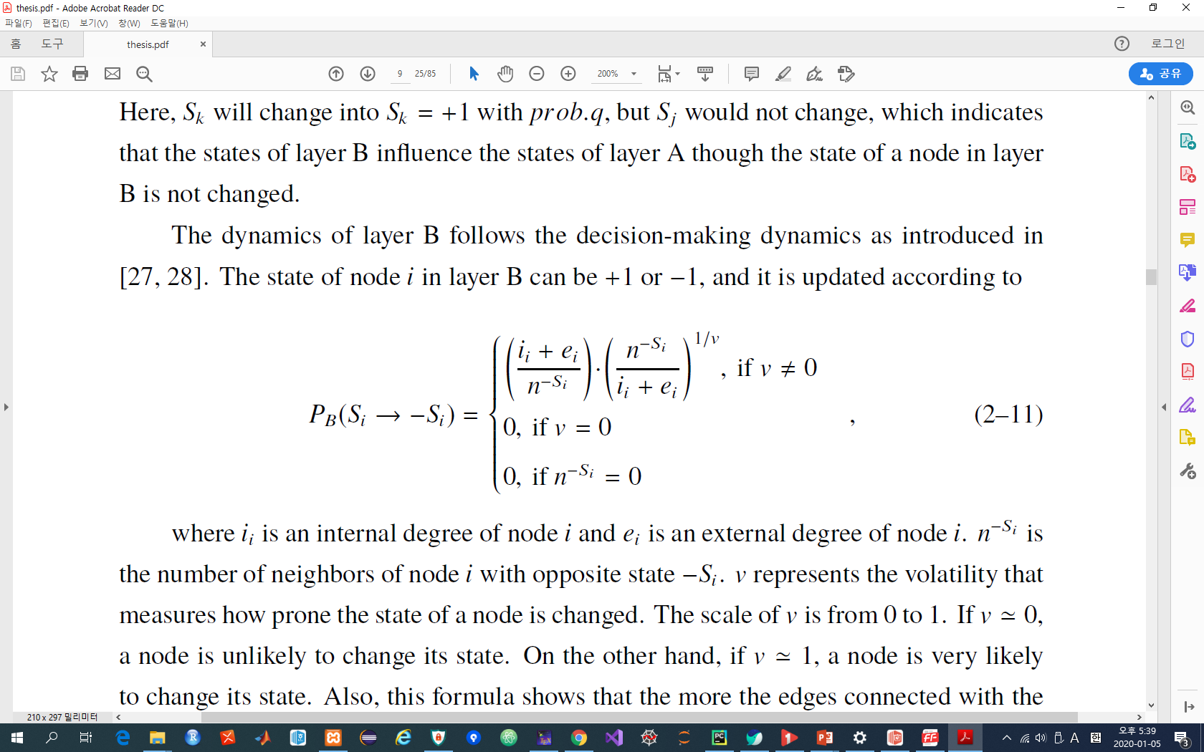
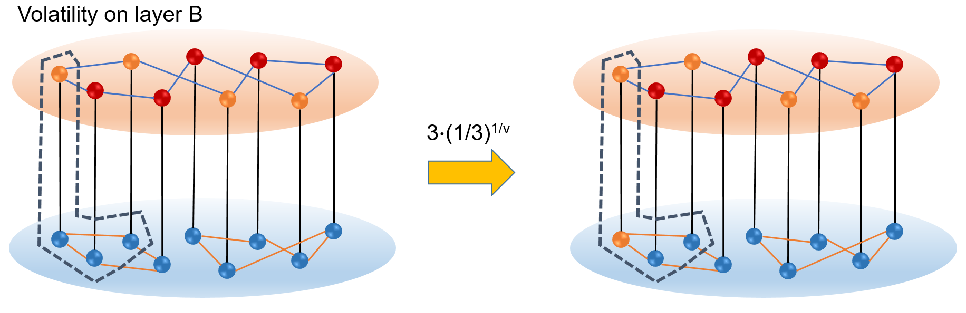
A Two-layer Network Model
Dynamics Algorithm for layer B
Abrams - Strogatz Model(Language Death Model / AS Model)
This model is only for binary state such as (+1, -1 ）or (1, 0）
* Volatility(v) : the tendency to switch to the other side
Notes:
Next, this is the dynamics algorithm for layer B. We use Abrams and Strogatz model that is known as language death model.
This model can have only binary states. And the states are changed by neighbor states. The number of the opposite orientation nodes have influence on changing the state of a node.
And as a dynamics parameter, index v works for volatility. v represents for the tendency to switch to the other side.

Slide 10
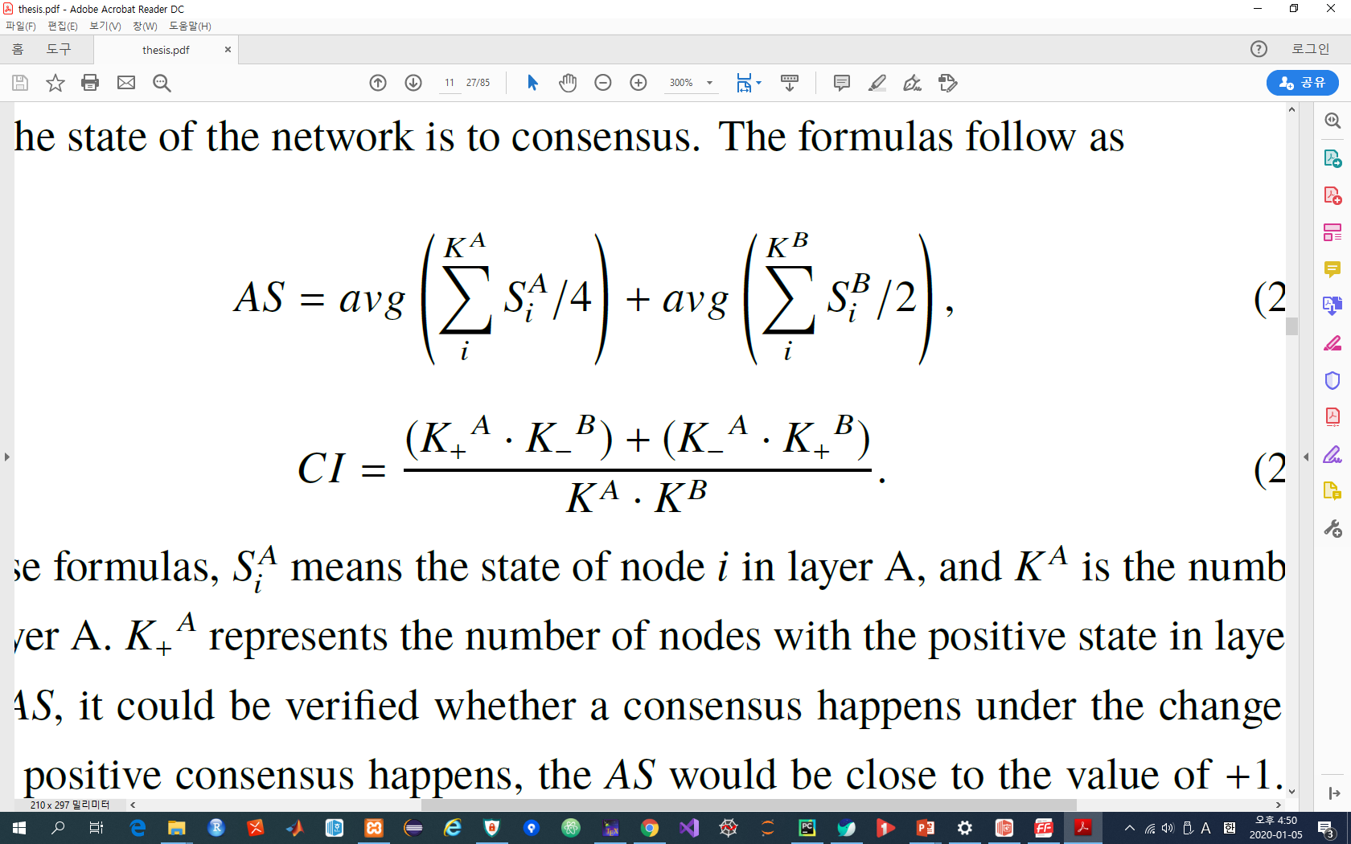
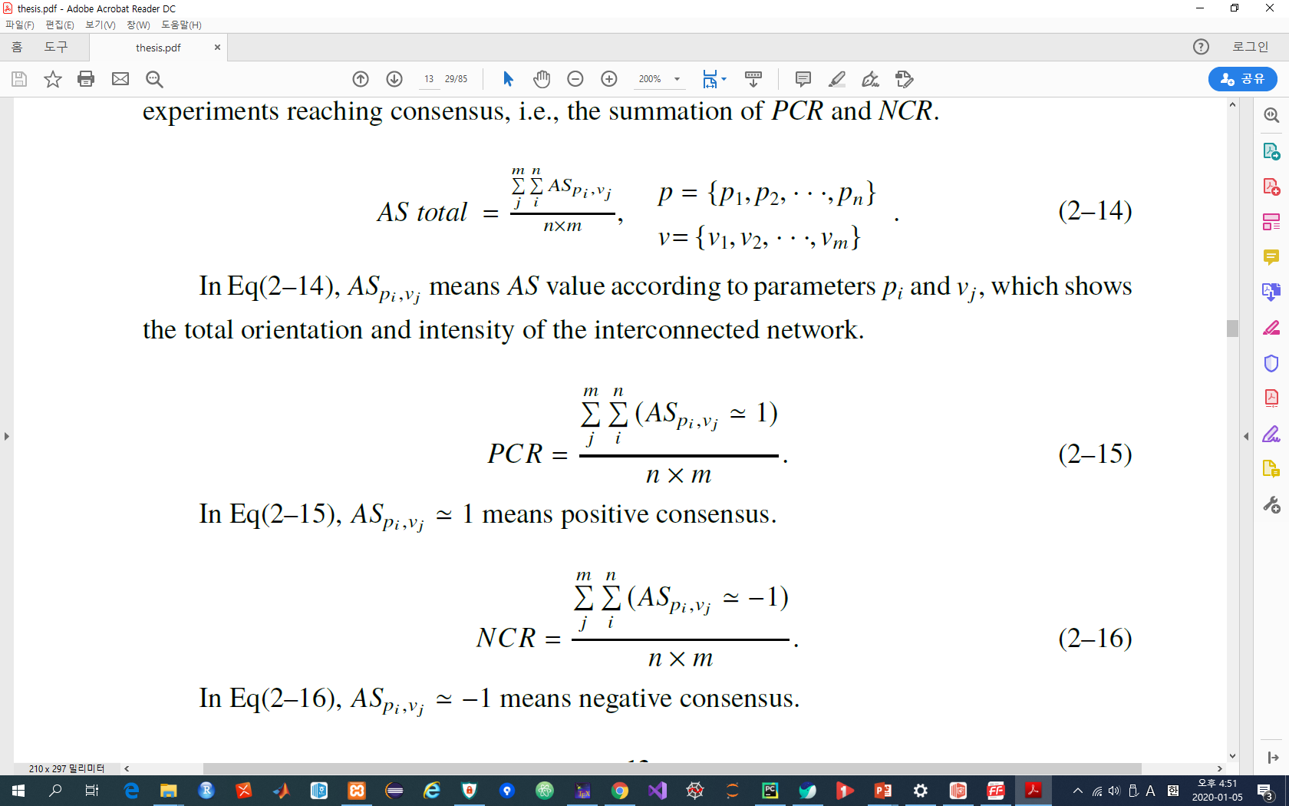
A Two-layer Network Model
Indexes for measuring network states and consensus(1)
- AS(Average State) : it is verified whether the consensus happens or not.
* AS ≈ +1 : positive consensus, AS ≈ -1 : negative consensus
- AS total : the summation of AS for all p values and all v values
- CI(Consensus Index) : It is measured how close the state is to a consensus.
* CI ≈ 0 : consensus, CI ≈ 1 : separated coexistence, CI ≈ 0.5 : mixed coexistence
Notes:
Next, some indexes are provided for measuring a consensus and a state of the network.
Average state could be verified whether the consensus happen or not.
AS total means the summation of AS for all parameters.
With CI, it is measured how close the state is to a consensus.

Slide 11
A Two-layer Network Model
Indexes for measuring network states and consensus(2)
- PCR(Positive Consensus Ratio) : the ratio of positive consensus over simulations
with all parameters
- NCR(Negative Consensus Ratio) : the ratio of negative consensus over simulations
with all parameters
- CR(Consensus Ratio) : PCR + NCR
- Coexistence Ratio : 1 - CR
Notes:
PCR is the ratio of positive consensus.
NCR is the ratio of negative consensus.
CR is Consensus Ratio, the summation of PCR and NCR
Coexistence Ratio is 1-CR.

Slide 12
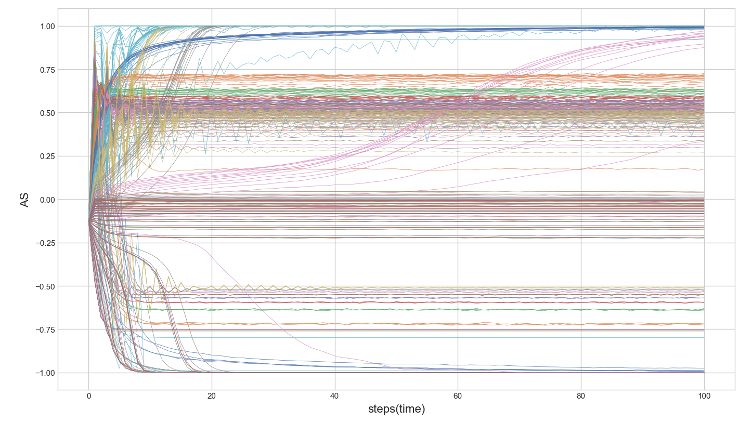
A Two-layer Network Model
‘AS’ values per each step according to all parameters
Positive consensus
Coexistence
Negative consensus
Notes:
This figure is AS values per each step according to all parameters.
With AS index, the state of a network can be categorized into three final states, such as positive consensus, coexistence, and negative consensus.

Slide 13
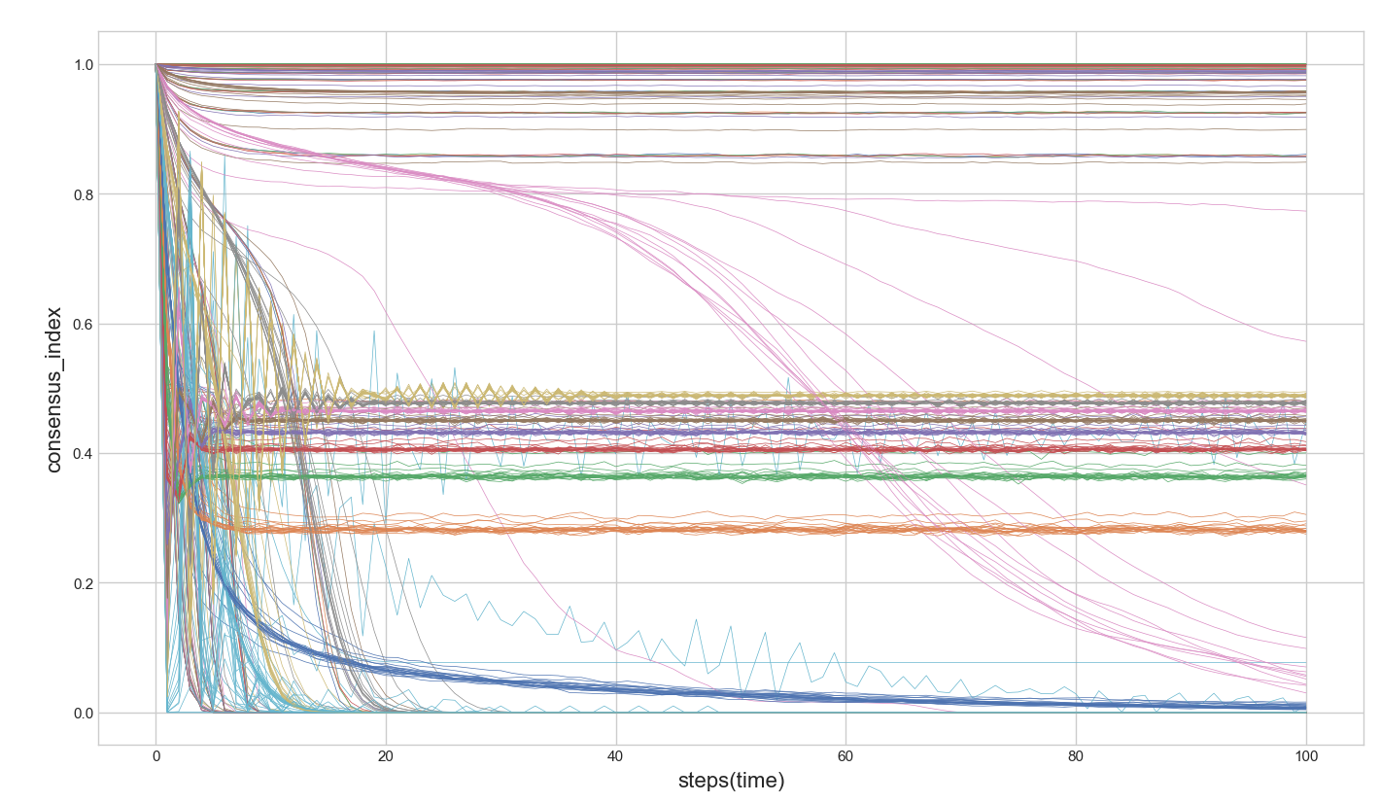
A Two-layer Network Model
‘CI’ values per each step according to all parameters
Separated coexistence
Mixed coexistence
Consensus
Notes:
This figure is CI values per each step according to all parameters.
With CI index, the state of a network can be categorized into three final states, such as a separated coexistence, mixed coexistence, and consensus.

Slide 14
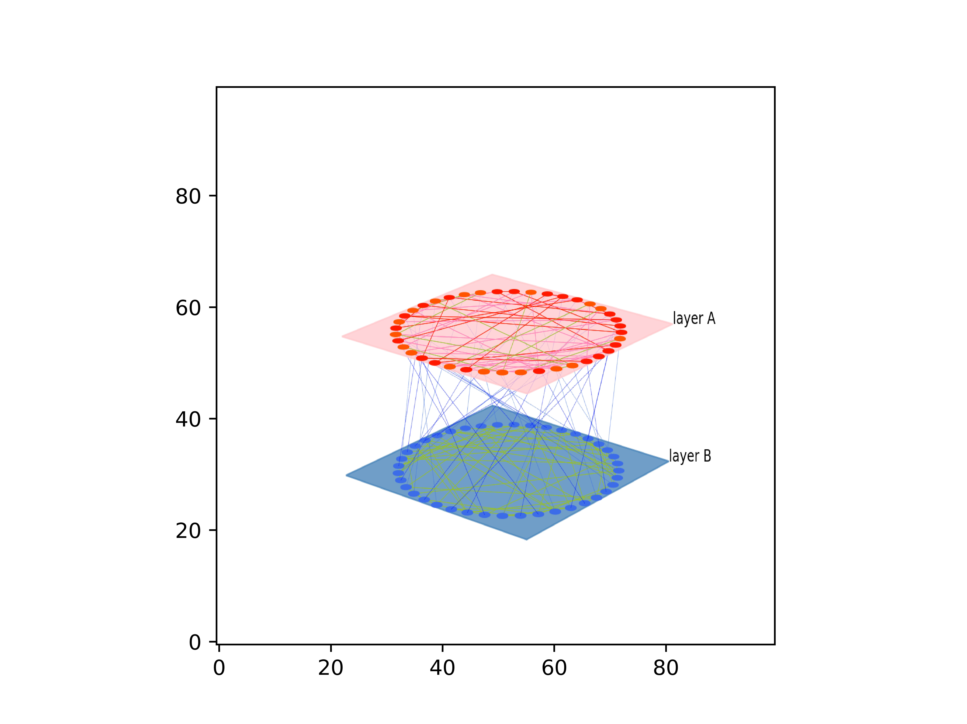

A Two-layer Network Model
Dynamics on network with two layers
Positive consensus
Negative consensus
Notes:
I will show you two animation of a competition model.
One makes a positive consensus.
The other makes a negative consensus.

Slide 15
Simulation Results
Competition on a two-layer network with various structures
Competition with different updating rules
Influences of key nodes on competition
Notes:
Next, Simulation results of 3 topics.
First, competition on a two-layer network with various structures.
Second, competition with different updating rules.
Third, influences of key nodes on competition.

Slide 16
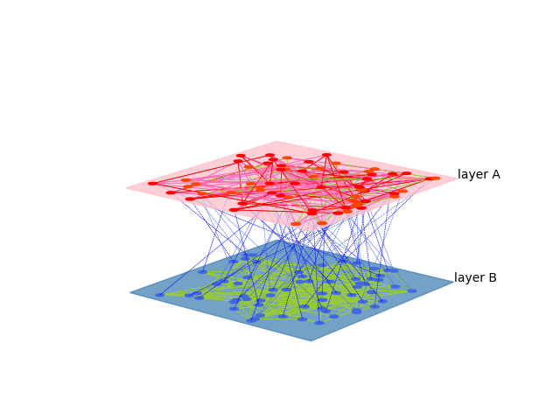
Competition on a two-layer network with various structures
Competition on Random Regular(RR) Networks(1)
- Each layer consists of random
regular network which has 2048
nodes.
- Each node has 5 internal edges
and 1 external edge.
This competition is basic model for comparison.
Based on this model, the structures of a model are changed and modified.
Notes:
First, competition on a two-layer network with various structures.
Competition on Random Regular networks.
In this model, each layer consists of a random regular network that has 2048 nodes. And each node has 5 internal edges and 1 external edge.
This model is simulated as basic model.

Slide 17
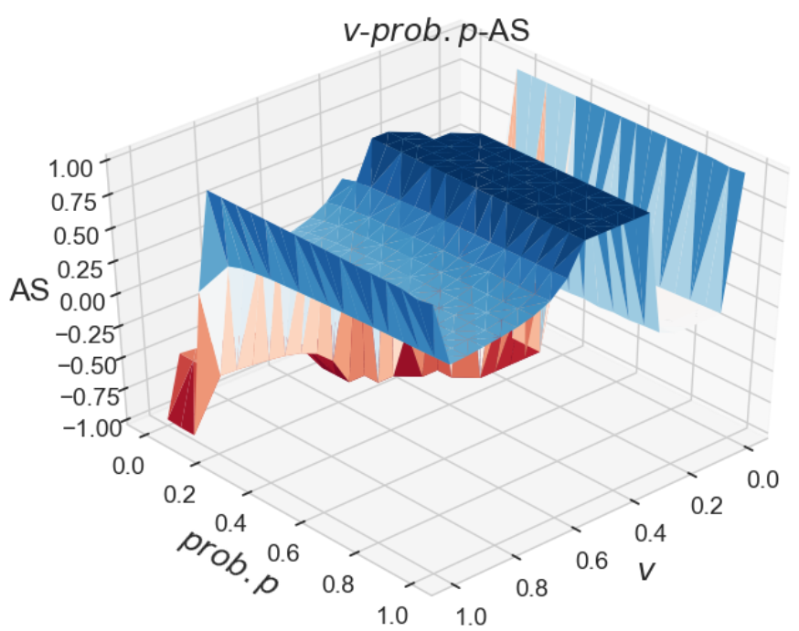
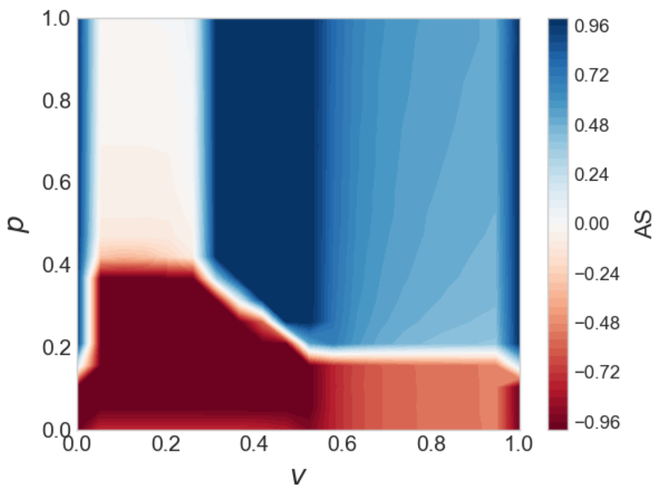
Competition on a two-layer network with various structures
Competition on Random Regular(RR) Networks(2)
Simulation results with all parameters(p, v)
Blue : positive consensus / Red : negative consensus / Light colored and white : coexistence
- There exist three final states(positive consensus, negative consensus, coexistence).
- By using these values and figures, various models are compared with this model.
Notes:
This is the result of competition on Random Regular networks.
In this figure, blue area is positive consensus, red area is negative consensus, and light colored and white area is coexistence
It is recognized that there exist three final states, such as positive consensus, negative consensus, and coexistence.
By using these values and figures, various models are compared with this model.

Slide 18
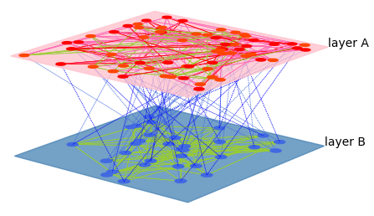
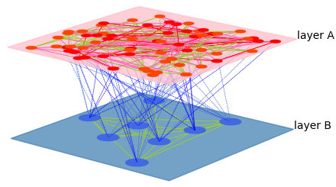
Competition on a two-layer network with various structures
Competition on Networks with different number of external links(1)
HM(2) : Each node in layer B has 2 external edges
HM(8) : Each node in layer B has 8 external edges
We denote HM(n) as a hierarchical model with a level n, which means that the number of nodes in layer B is 1 / n of the number of nodes in layer A, and the number of external links from a node in layer B is n, in view that the number of external links from a node in layer A is 1.
Notes:
Next, the simulations are implemented by changing the external degree.
This model is called as a hierarchical model. And we denote HM(n) as a hierarchical model with a level n.
For example, HM(2) means each node in layer B has 2 external edges.

Slide 19
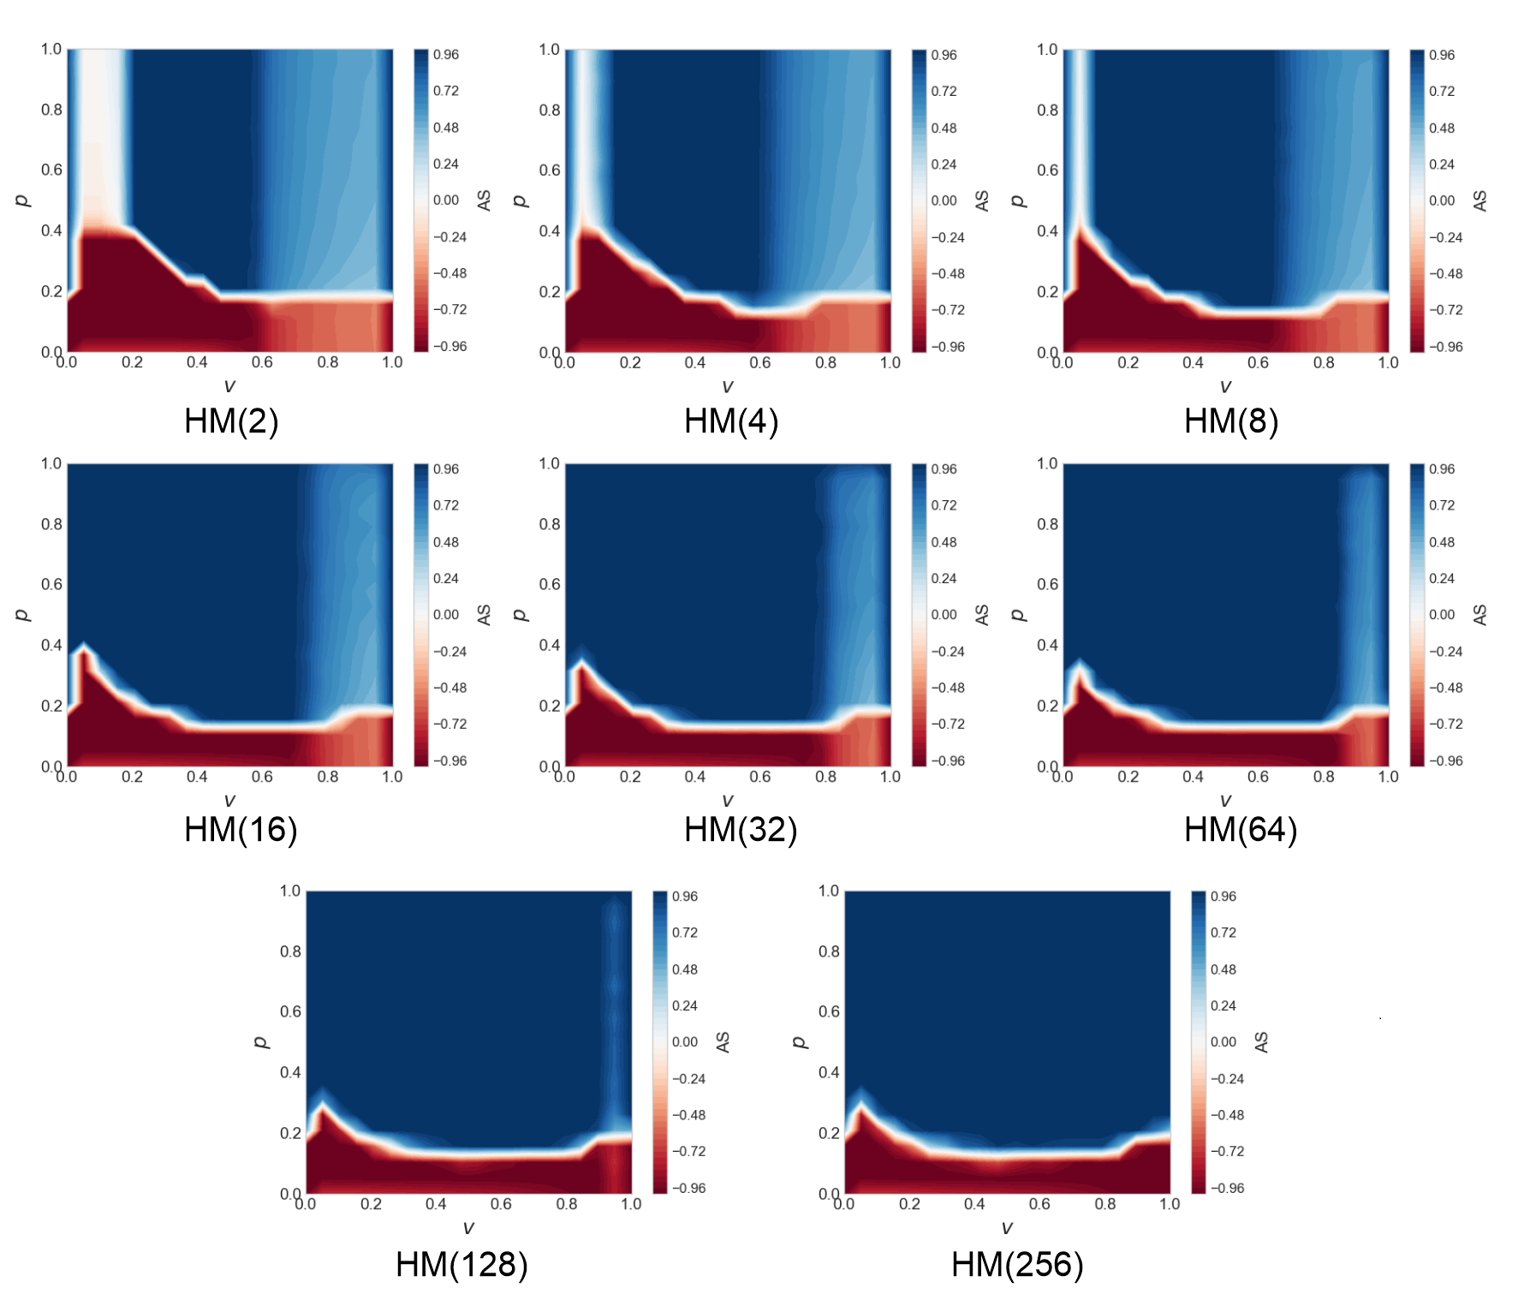
Competition on a two-layer network with various structures
Competition on Networks with different number of external links(2)
- The largest area for coexistence :
HM(2)
- The largest area for consensus :
HM(256)
- As n in HM(n) is increased, the
coexistence area is decreased,
and the consensus area is
increased.
Notes:
Various hierarchical models are simulated. The simulation results of 8 hierarchical models are arranged.
HM(2) has the most significant coexistence part.
And HM(256) has the most significant consensus part.
As n is increased, the coexistence area is decreased and the consensus area is increased.

Slide 20
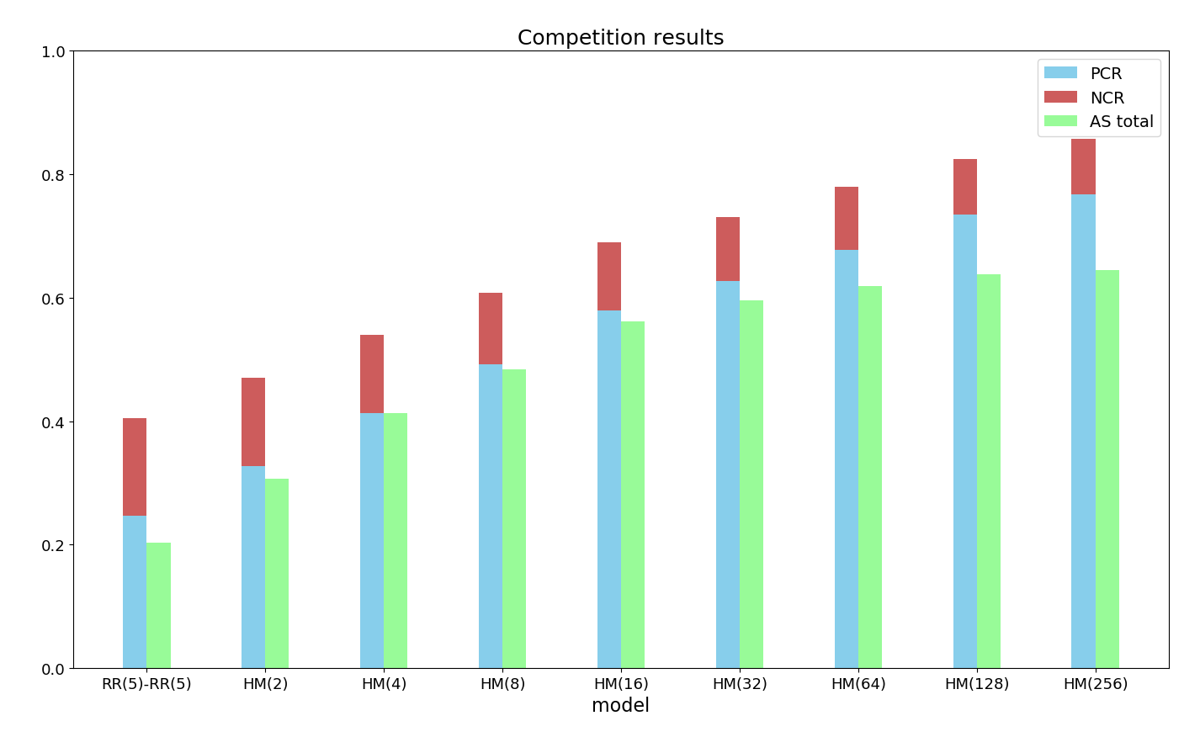
Competition on a two-layer network with various structures
Competition on Networks with different number of external links(3)
- The simulation result are analyzed by
using the indexes, such as PCR, NCR, AS
total.
- Consensus ratio : all HMs > RRM
* PCR : all HMs > RRM
* NCR : all HMs < RRM
→ As the number of external edges is
increased and the number of nodes in
layer B is decreased, the network makes
it easier to have a positive consensus
and harder to have a negative consensus.
Notes:
To obtain the difference between models, we use the indexes, PCR, NCR, and AS total.
The blue color bar is PCR, the red color bar is NCR, and the green color bar is AS total.
Comparing hierarchical models with the Basic model, CR, PCR, and AS total are all increased remarkably.
Hierarchical models have a larger positive consensus area than the basic model
Moreover, Hierarchical models have a smaller negative consensus area than the basic model.
In conclusion, hierarchical models make it easier to have a positive consensus and harder to have a negative consensus.

Slide 21
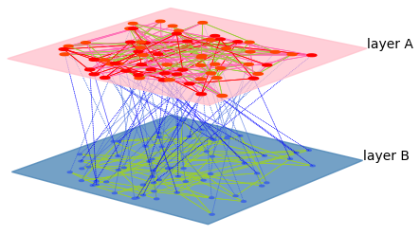
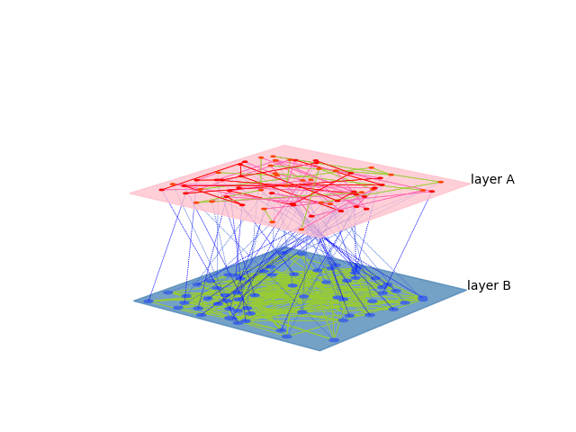
Competition on a two-layer network with various structures
Competition on Networks with different number of internal links(1)
RR(5)-RR(2)
RR(2)-RR(5)
RR(n)-RR(m) : layer A has a random regular network with n internal edges per node, and layer B has a random regular network with m internal edges per node.
To define and evaluate the influence of internal degrees,
the internal degree on each node is switched to 2, 3, 4, or 5.
Notes:
Next, the simulations are implemented by changing the internal degree.
To define and evaluate the influence of internal degrees, the internal degree on each node is switched to 2, 3, 4, or 5.

Slide 22
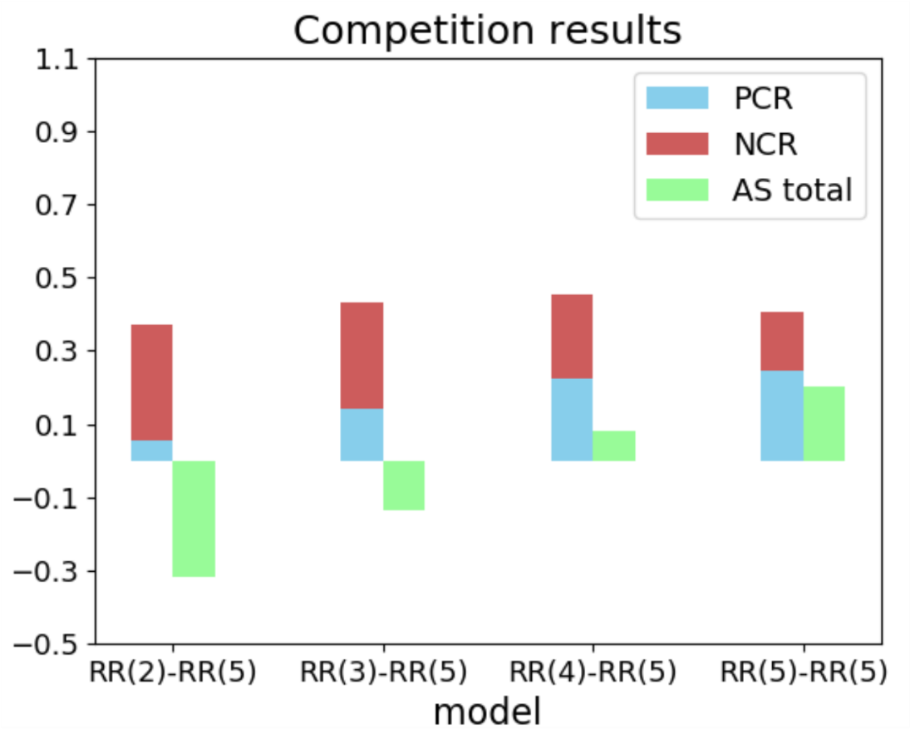
Competition on a two-layer network with various structures
Competition on Networks with different number of internal links(2)
① The internal degree on layer A is changed to 2, 3, 4, or 5
- The largest area for a positive consensus :
RR(5)-RR(5)
- The largest area for a negative consensus :
RR(2)-RR(5)
- As the internal degree on layer A is increased,
the negative consensus is decreased and
the positive consensus is increased.
The internal degree on layer A tends to
keep a positive state and to change a
negative state into a positive state.
Notes:
First, the internal degree on layer A is changed.
The results are shown in this figure.
The largest positive consensus is RR(5)-RR(5).
The largest negative consensus is RR(2)-RR(5).
As the internal degree on layer A is increased, the negative consensus is decreased and the positive consensus is increased.
The internal degree on layer A tends to keep a positive state and to change a negative state into a positive state.

Slide 23
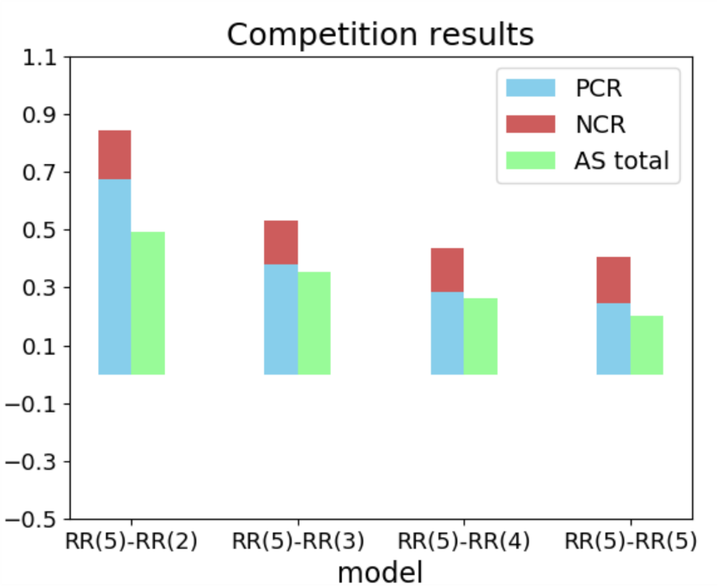
Competition on a two-layer network with various structures
Competition on Networks with different number of internal links(3)
② The internal degree on layer B is changed to 2, 3, 4, or 5
- The largest area for a positive consensus :
RR(5)-RR(2)
- All models have almost the same NCR
- As the internal degree on layer B is increased,
the positive consensus is decreased.
The internal degree on layer B tends to
hinder the positive consensus state.
Notes:
Second, the internal degree on layer B is changed.
The results are shown in this figure.
The largest positive consensus is RR(5)-RR(2).
And, all models have almost the same NCR.
As the internal degree on layer B is increased, the positive consensus is decreased.
The internal degree on layer B tends to hinder the positive consensus state

Slide 24
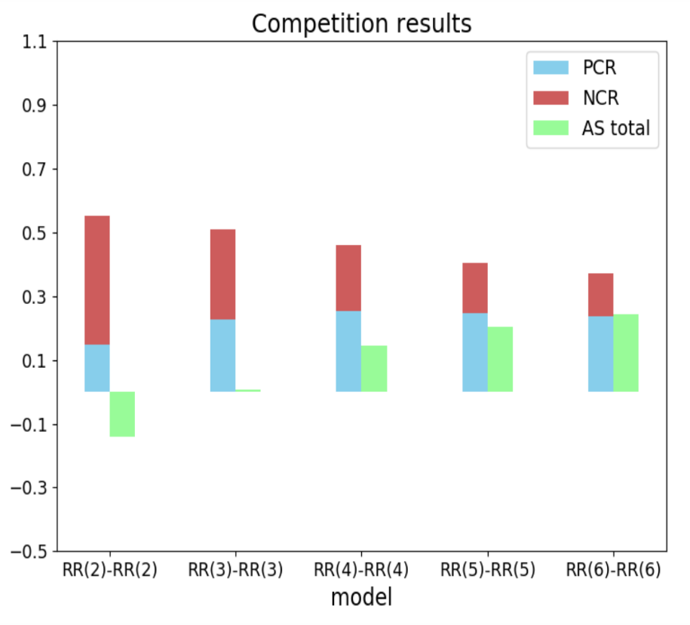
Competition on a two-layer network with various structures
Competition on Networks with different number of internal links(3)
③ The internal degrees on both layers are changed to 2, 3, 4, or 5
- The largest area for a coexistence :
RR(6)-RR(6)
- The largest area for a consensus :
RR(2)-RR(2)
- As the internal degree on both layers is
increased, Consensus Ratio(CR) is inversely
decreased.
A massive internal degree on both layers
makes it hard for network to reach consensus.
Notes:
Third, the internal degrees on both layers are changed.
The results are shown in this figure.
The largest coexistence is RR(6)-RR(6).
The largest consensus is RR(2)-RR(2)
As the internal degree on both layers is increased, Consensus Ratio is inversely decreased.
A massive internal degree on both layers makes it hard for the network to reach consensus.

Slide 25
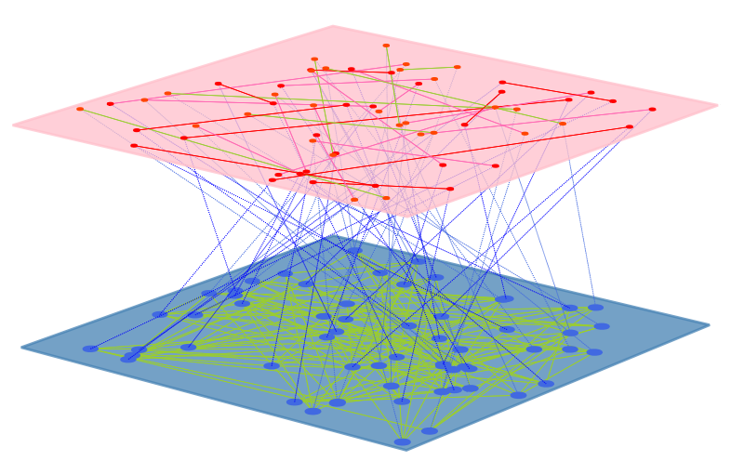
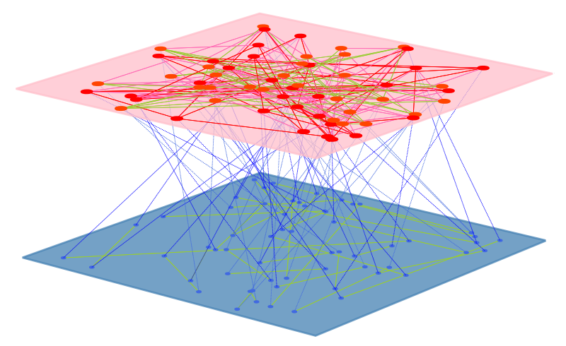
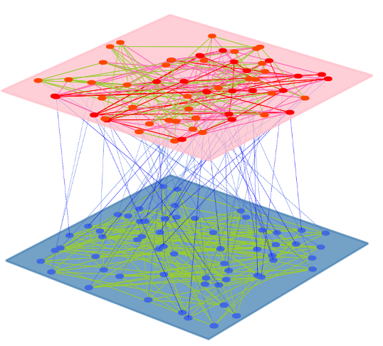
Competition on a two-layer network with various structures
Competition on Networks with different number of internal links(4)
Model
internal degree on layer A | small | large | large
internal degree on layer B | large or small | small | large
final state | easy to reach negative consensus | easy to reach positive consensus | Coexistence
Notes:
Related to an internal degree, several conclusions can be arranged as this table.
First, it is easy to reach a negative consensus when the internal degree on layer A is relatively small.
Second, it is easy to make a positive consensus when the internal degree on layer A is relatively large, and the internal degree on layer B is relatively small.
Third, it is easy to make a coexistence when the internal degrees on both layers are too large.

Slide 26
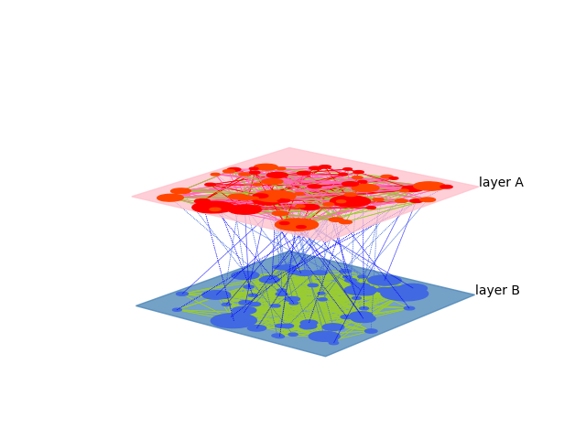
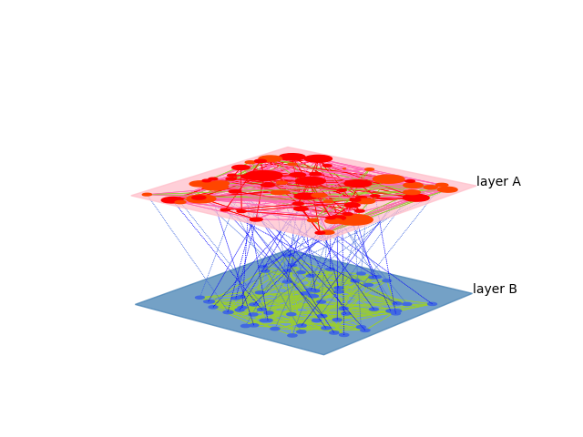
Competition on a two-layer network with various structures
Competition on Networks with different network types(1)
BA-BA
BA-RR
To evaluate the influence of network types,
the Barabasi-Albert(BA) or Random Regular(RR) network is applied for both layers or switched on each layer.
Notes:
Next, the simulations are implemented by changing the network types.
the Barabasi-Albert(BA) or Random Regular(RR) network is applied for both layers or switched on each layer.

Slide 27
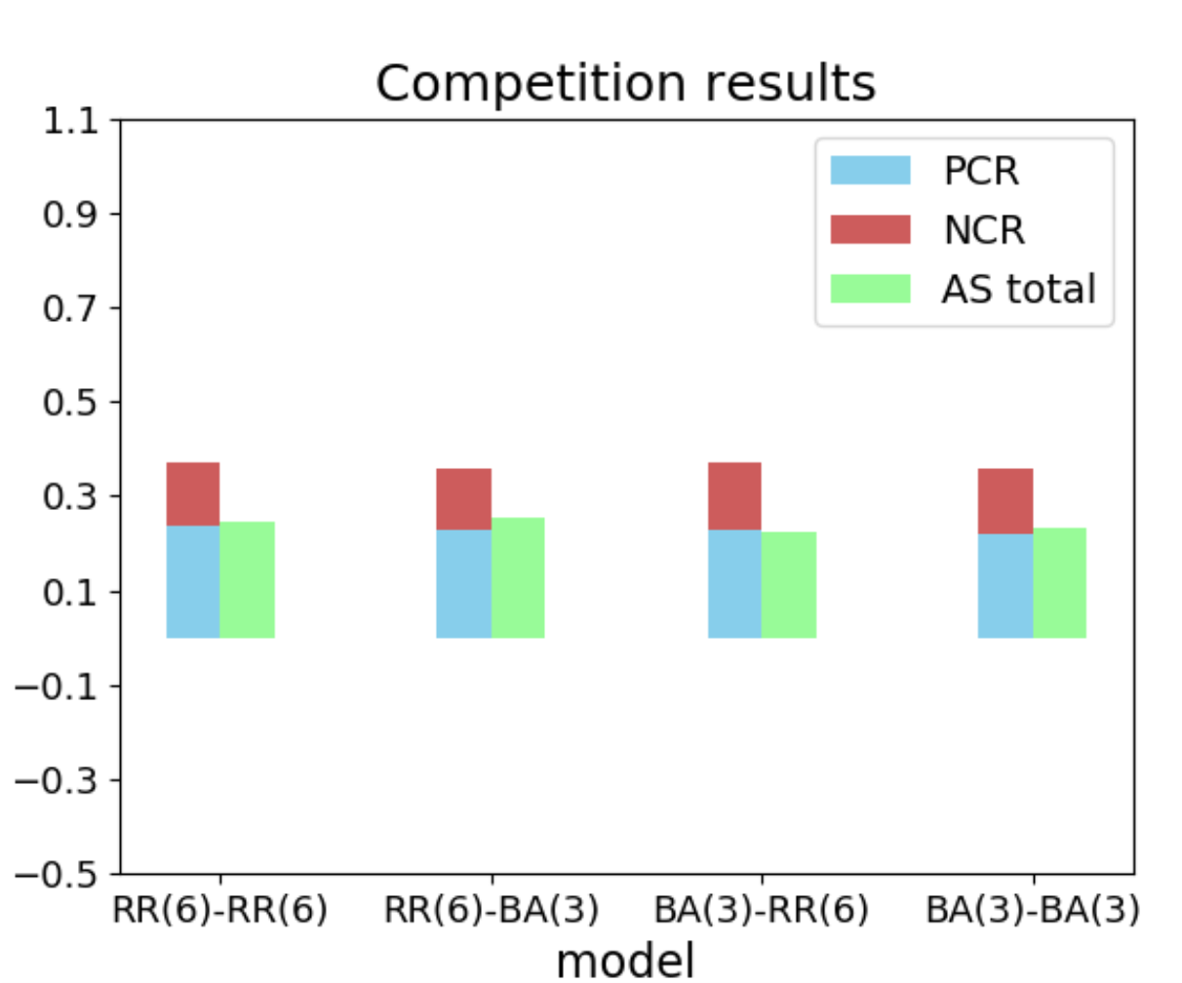
Competition on a two-layer network with various structures
Competition on Networks with different network types(2)
consensus result :
Structures | A edges | B edges | Consensus (P : N)
RR(6)-RR(6) | 6,144 | 6,144 | 0.235 : 0.138
RR(6)-BA(3) | 6,144 | 6,135 | 0.228 : 0.130
BA(3)-RR(6) | 6,135 | 6,144 | 0.230 : 0.143
BA(3)-BA(3) | 6,135 | 6,135 | 0.220 : 0.140
- Simulation results are almost the same.
* All models have almost the same PCR
and NCR.
The network types make no obvious
difference of consensus results
Notes:
4 models have the different network types and they are simulated.
As shown in this figure and table, the results are almost the same.
The network types make no obvious difference.

Slide 28
Competition on a two-layer network with various structures
Conclusion
- Both internal and external degree have a vital role for changing the state of network.
- As the role of an external degree, Hierarchical Models show that they are easy to
make a consensus on a two-layer network.
- As the role of an internal degree, an internal degree on each layer has a different function.
① Layer A : An internal degree tends to keep a positive state and
to change a negative state into a positive state.
② Layer B : An internal degree tends to hinder a positive consensus state.
- Too many internal edges on each layer make the networks hard to reach
a consensus due to inner conflicts.
* Those facts could be used to make network structures and organizations in the real world.
Notes:
Conclusion for the first topic.
First, both internal and external degree have a vital role for changing the state.
Second, Hierarchical Models show that they are easy to make a consensus.
Third, an internal degree on each layer has a different function as follows.
For layer A, an internal degree tends to keep a positive state and to change a negative state into a positive state.
For layer B, an internal degree tends to hinder a positive consensus state.
Fourth, too many internal edges on each layer make the networks hard to reach a consensus.
Those facts could be used to make network structures and organizations in the real world.

Slide 29
Competition with different updating rules
Updating rules
- There are many ways to update the state of nodes. With considering time-related
updating rules, sequential and simultaneous updating rules can be investigated.
- According to where the updating rules are applied, the cases are divided into three
level, such as layers, nodes, and edges.
① order of layers : whether layer A works first, or layer B works first, or both layers
work together(randomly).
② order of nodes : whether the states of nodes are changed simultaneously or
sequentially or randomly.
③ order of edges : where edges are activated on a node sequentially or
simultaneously or randomly.
- To sum up, 25 updating rules are simulated according to layers, nodes, and edges.
Notes:
Second topic, competition with different updating rules.
There are many ways to update the state of nodes. Here, we investigate sequential and simultaneous updating rules.
According to where the updating rules are applied, the cases are divided into three level, such as layers, nodes, and edges.
To sum up, 25 updating rules are simulated according to layers, nodes and edges.

Slide 30
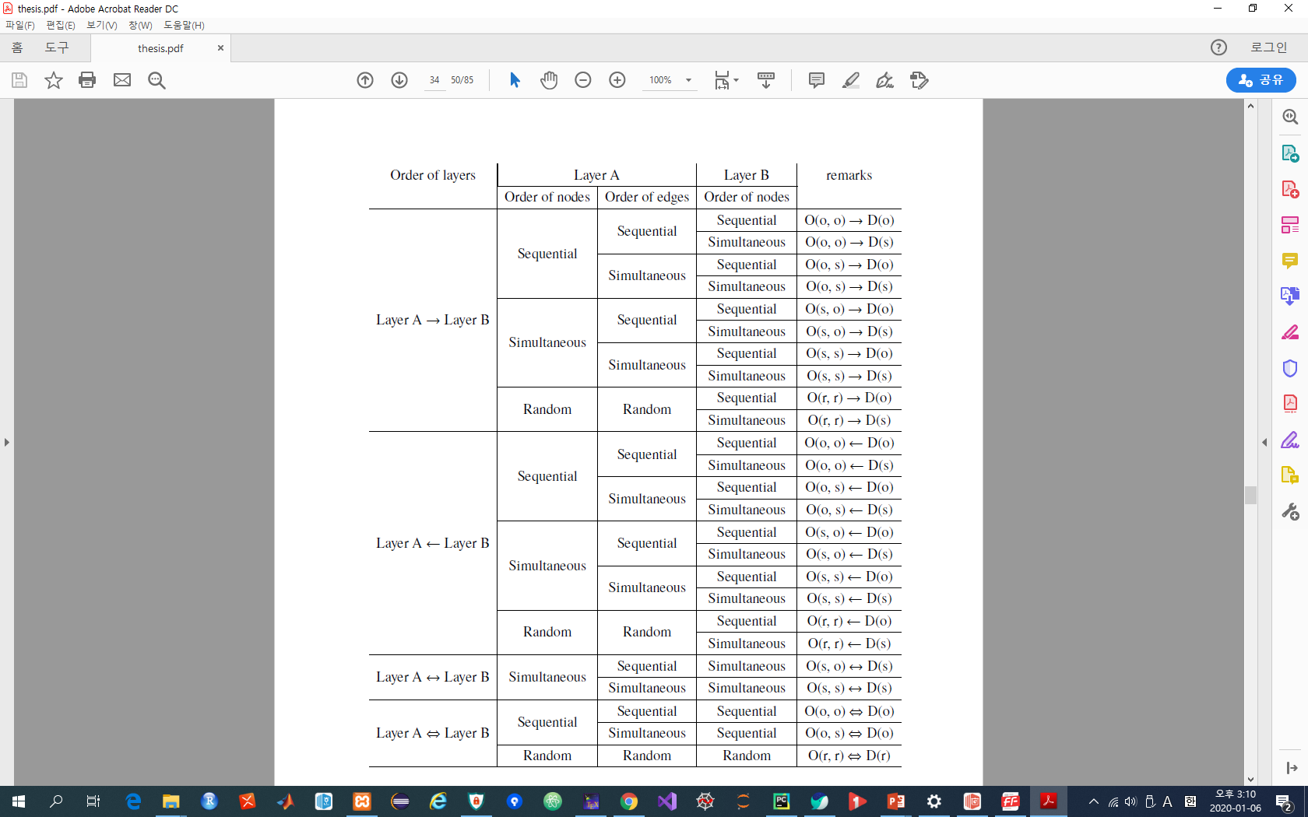
Competition with different updating rules
- ‘O(o, o)→D(s)’ :
‘Opinion layer(nodes: sequential, edges: sequential) →
Decision-Making layer(node: simultaneous)’
- Initial conditions
① Structures : BA(3)-BA(3)
② parameters : p=0.4, v=0.4.
Notes:
This table shows all updating rules according to layer order, node order, and edge order.
The updating rules are denoted as the lists on the remarks.

Slide 31
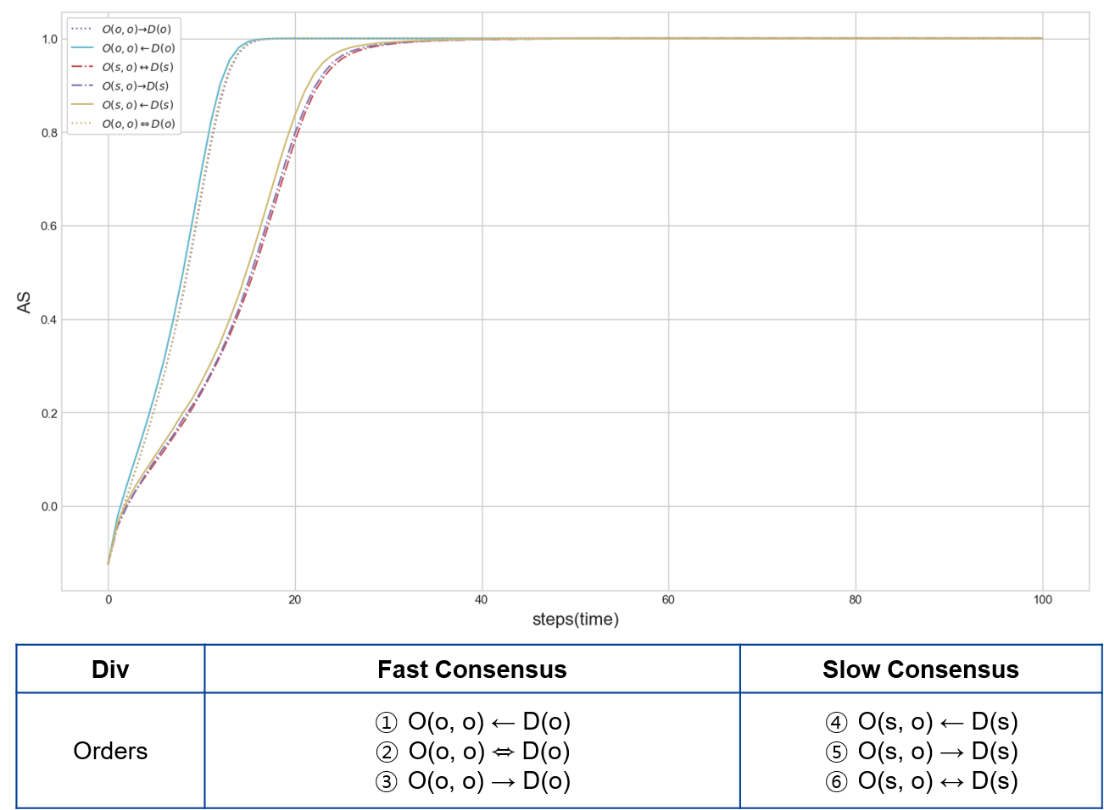
Competition with different updating rules
Simulation results : Order of layers
Positive consensus
- There is little difference
between the orders of layers
* The graph line indicates AS values per each step.
The arrow directions does
not make different results
Notes:
This is the results for orders of layers.
The graph line indicates AS values per each step.
As shown in this table, the arrow direction does not make different results.
Therefore, there is little difference between the orders of layers.

Slide 32
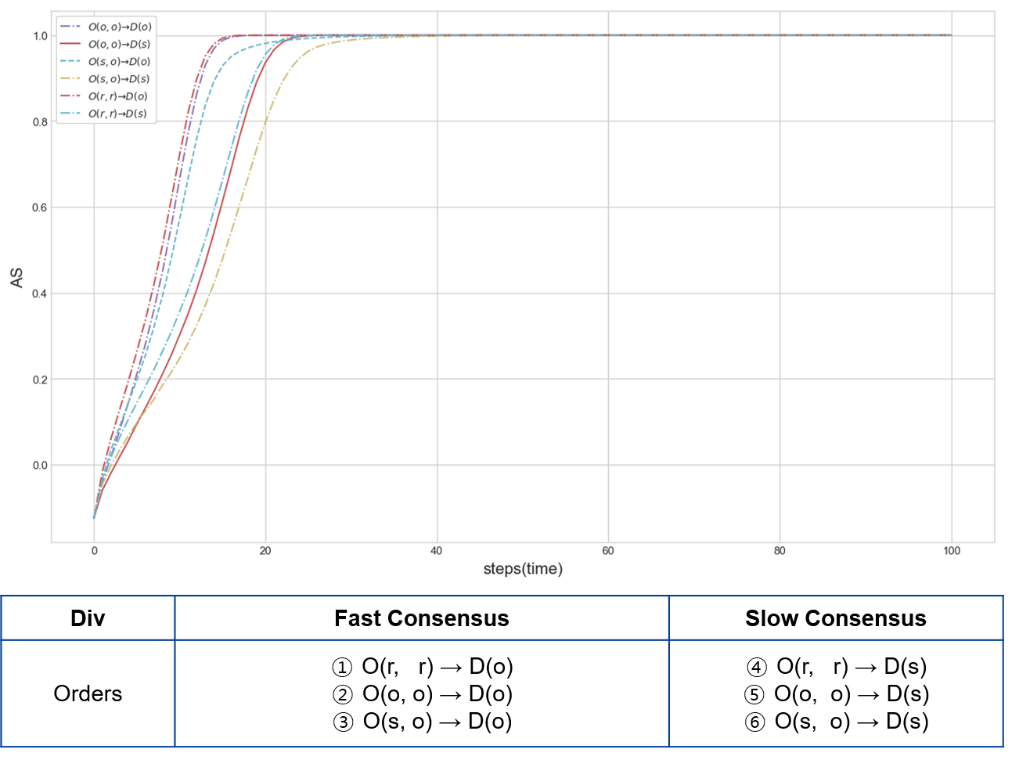
Competition with different updating rules
Simulation results : Order of nodes
- An order of nodes can be analyzed as
communication method, such as
discussion, conversation, and vote.
* sequential : discussion
* simultaneous : vote
- The order of nodes in layer A does not
make different results.
- The order of nodes in layer B makes
different results, such as fast and slow
consensus.
Notes:
This is the results for orders of nodes.
An order of nodes can be analyzed as communication method.
Sequential updating rule is a discussion.
Simultaneous updating rule is a vote.
As shown in this table, the order of nodes in layer A does not make different result.
However, the order of nodes in layer B makes different results, such as fast and slow consensus.

Slide 33
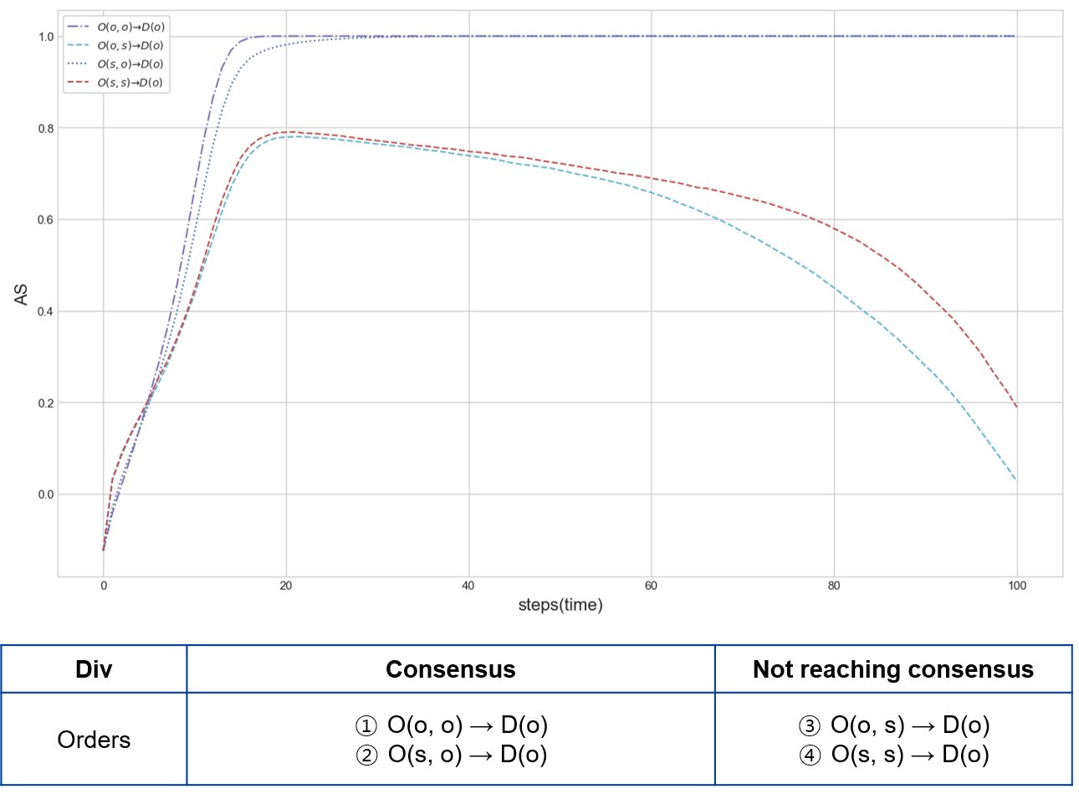
Competition with different updating rules
Simulation results : Order of edges
- Order of edges can be analyzed as
node characteristics, such as
‘rash’ and ‘considerate’.
* sequential : rash(easy to be extreme)
* simultaneous : considerate
(hard to be extreme)
- The order of edges in layer A makes
different result, such as consensus and
coexistence(not reaching consensus).
* The order of edges in layer B is always
simultaneous because the dynamics
formula considers all connected nodes
at the same time.
Notes:
This is the results for orders of edges.
Order of edges can be analyzed as node characteristics.
Sequential updating rules is rash, easy to be extreme.
Simultaneous updating rules is considerate, hard to be extreme.
The order of edges in layer A makes different result, such as consensus and coexistence.

Slide 34
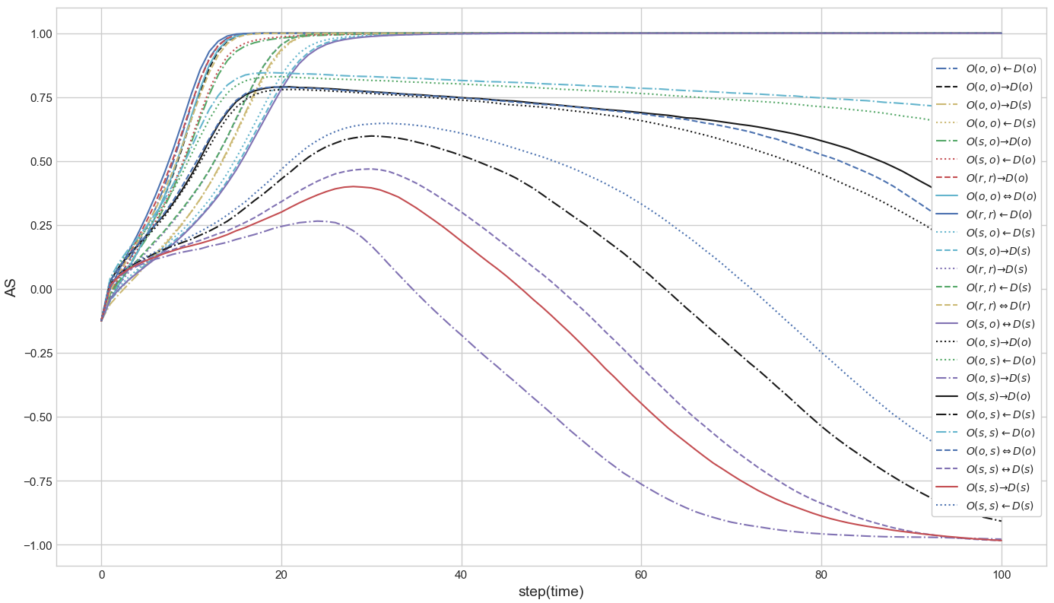
Competition with different updating rules
Total results with AS index
Positive consensus
Coexistence
Negative consensus
Notes:
This is the total results with AS index.
Under the same structures, the same parameters and the different updating rules, there exist 3 final states, such as positive consensus, coexistence, and negative consensus.

Slide 35
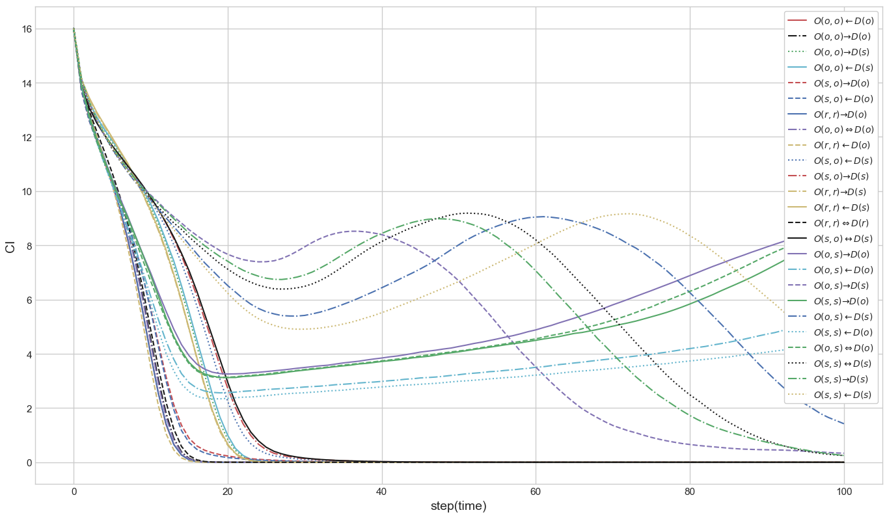
Competition with different updating rules
Total results with CI index : 3 branch points are shown.
3 branch points
Transition to the opposite state
Notes:
This is the total results with CI Index.
In this figure, 3 branch points are shown. And the transition part is also shown.
The branch points have a influence on the final state.

Slide 36
Competition with different updating rules
Total results analysis
1st B. P. Order of nodes in layer B | 2nd / 3rd B. P. Order of edges in layer A | Final state
Fast (Sequential) | Positive (Sequential) | Fast positive consensus
 | Negative (Simultaneous) | Coexistence
Slow (Simultaneous) | Positive (Sequential) | Slow positive consensus
 | Negative (Simultaneous) | Slow negative consensus
- As the first branch point, order of nodes in layer B has a vital role for making consensus time,
such as fast and slow
- As the second and third branch points, order of edges in layer A is very influential for determining
the final state, such as positive, negative, and sometimes mixed.
Notes:
The total result can be arranged as this table.
As the first branch point, order of nodes in layer B has a vital role for making consensus time.
As the second and third branch points, order of edges in layer A is very influential for determining the final state.

Slide 37
Competition with different updating rules
Conclusion
- Networks with simultaneous updating rules tend to make slow consensus or
coexistence, sometimes make the transition to the opposite state.
- Networks with sequential updating rules tend to make fast consensus
- The order of nodes in layer B is very important for determining consensus time.
It is analyzed that communication method affects the consensus time.
- The order of edges in layer A is very influential for determining the final states,
such as same orientation consensus, opposite orientation consensus, and
coexistence. It is analyzed that node characteristics make the final state of a network.
Notes:
Conclusion for the second topic.
First, networks with simultaneous updating rules tend to make slow consensus or coexistence, sometimes make the transition
Second, networks with sequential updating rules tend to make fast consensus
Third, the order of nodes in layer B is very important for determining consensus time.
Fourth, the order of edges in layer A is very influential for determining the final states.

Slide 38
Influences of key nodes on competition
Method for selecting key nodes
- In order to demonstrate the influence of key nodes, we use stubborn nodes,
which do not change their states during the opinion evolution.
- Stubborn nodes are selected by using some indexes, node centralities, such as
Pagerank, degree, betweenness, and combinations of them.
- The steps are as follows :
① As initial conditions, a layer is selected to identify key nodes, and parameters
are set to be the opposite consensus state with the selected layer.
② The centralities of all nodes are calculated and ranked as orders.
③ The ratio of stubborn nodes are increased according to ranked order
until the network has different states.
④ By the summation of AS(Average State), it is measured which method is the
most powerful for selecting key nodes.
Notes:
Third topic, influences of key nodes on competition.
In order to demonstrate the influence of key nodes, we use stubborn nodes, which do not change their states during the opinion evolution.
Stubborn nodes are selected by using node centralities and combinations of them.
The steps for selecting key nodes are as follows :
First, a layer is selected to identify key nodes, and parameters are set to be the opposite state.
Second, the centralities of all nodes are calculated and ranked as orders.
Third, the ratio of stubborn nodes are increased according to ranked order until the network has different states.
Fourth, by the summation of Average State, it is measured which method is the most powerful for selecting key nodes.

Slide 39
Influences of key nodes on competition
Single Indicators
- Pagerank, Closeness, Betweenness, Degree, Eigenvector
Multiple Indicators : calculated by the summation of node centrality ranks
* ex) Pagerank + Degree(PR+DE), Pagerank + Degree + Betweenness(PR+DE+BE)
① Several efficient single indicators are selected.(Pagerank, Degree, Betweenness)
② All nodes are ranked by each selected node centralities.
Combined node centrality is the summation of all ranks which a node has.
All nodes are ranked again by combined node centrality.
(As the combined node centrality is smaller, a node are ranked higher.)
③ The nodes are deactivated from high ranked order until the state of
network has significant difference
Notes:
Next, single and multiple indicators are considered as methods for selecting key nodes. For single indicators, node centrailties are researched such as Pagerank, closeness, betweenness, degree, and eigenvector
Multiple indicators are considered as combined node centrality. Multiple indicators are calculated by the summation of node centraility ranks.
The way to calculate combined node centrality follows like these steps.
First, several efficient single indicators are selected.(Here, we use Pagerank, Degree, Betweenness)
Second, all nodes are ranked by each selected node centralities. Combined node centrality is the summation of all ranks which a node has.
Third, the nodes would be deactivated from high ranked order.

Slide 40
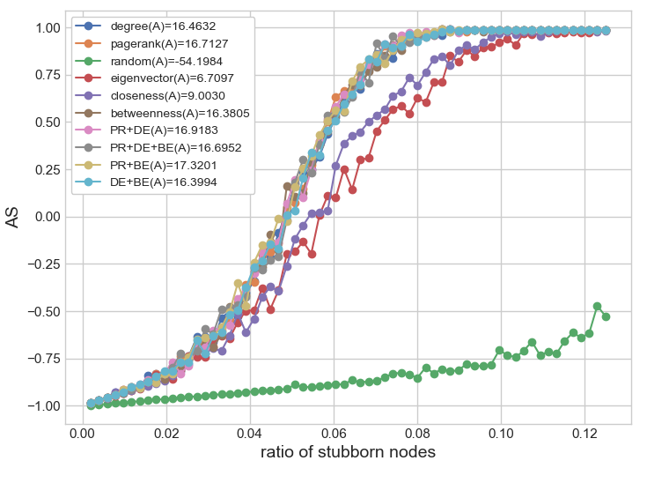
Influences of key nodes on competition
Key nodes on layer A / BA(3)-BA(3)
- As single indicators, Pagerank,
degee, and betweenness are
powerful for identifying key nodes.
- The best indicator : PR+BE
- Some multiple indicators have a
better performance than single
indicators.
Rank : PR+BE > PR+DE > Pagerank
Notes:
This is the results for selecting key nodes on layer A.
In this model, as single indicators, Pagerank, degree, and betweenness are powerful for identifying key nodes.
However, the best indicator is combination of Pagerank and betweenness.
It is found out that some multiple indicators have a better performance than single indicators.

Slide 41
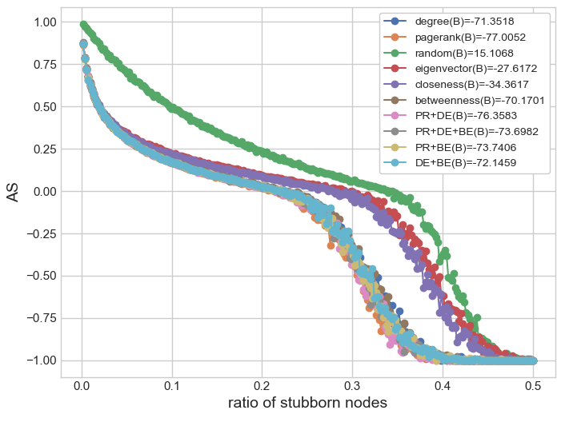
Influences of key nodes on competition
Key nodes on layer B / BA(3)-BA(3)
- The best indicator : Pagerank
- Although the multiple indicators
are not the best, they also have a
good performance
Rank : Pagerank > PR+DE > PR+BE
Notes:
This is the results for selecting key nodes on layer B.
The best indicator is Pagerank.
Although the multiple indicators are not the best, they also have a good performance.

Slide 42
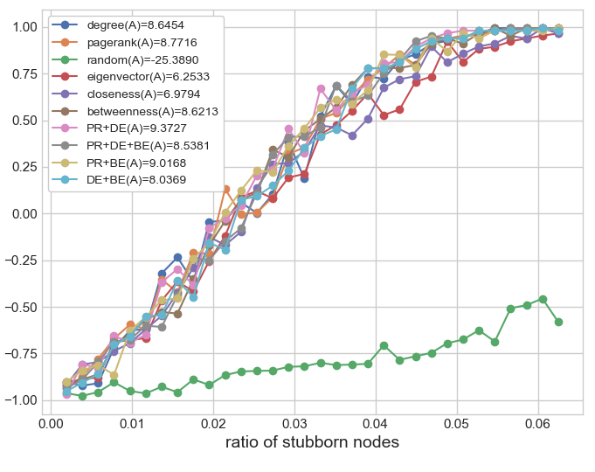
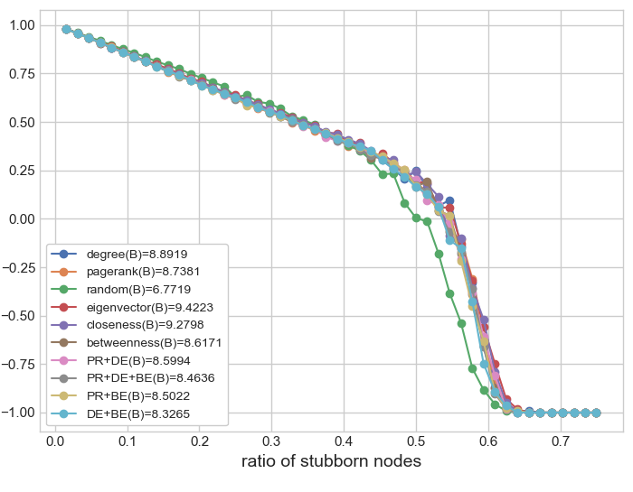
Influences of key nodes on competition
Key nodes on various networks(Hierarchical Model / HM(8) with BA(3))
Layer A
Layer B
Rank : PR+DE > PR+BE > Pagerank
Rank : random > DE+BE > PR+DE+BE
Notes:
Next, this is the results for selecting key nodes on Hierarchical Model.
On layer A, the best indicator is PR+DE.
On layer B, the best indicator is random. That means node centrality does not work here.

Slide 43
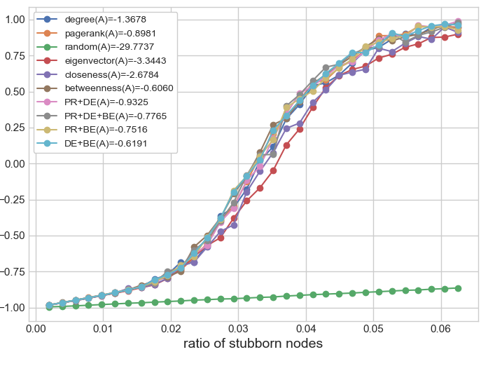
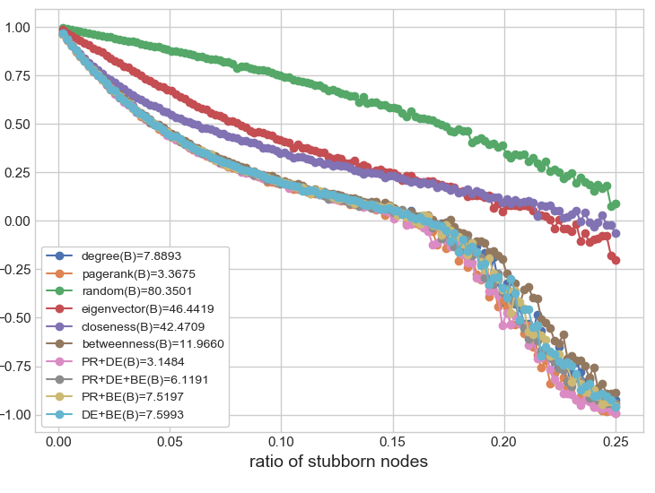
Influences of key nodes on competition
Key nodes on various networks(With different internal edges / BA(4)-BA(2))
① Layer A has a larger internal degree than layer B
Layer A
Layer B
Rank : betweenness > DE+BE > PR+BE
Rank : PR+DE > Pagerank > PR+DE+BE
Notes:
This is the results for selecting key nodes on the two-layer network with different internal edges.
This is the case that layer A has a larger internal degree than layer B.
On layer A, the best indicator is betweenness.
On layer B, the best indicator is PR+DE.

Slide 44
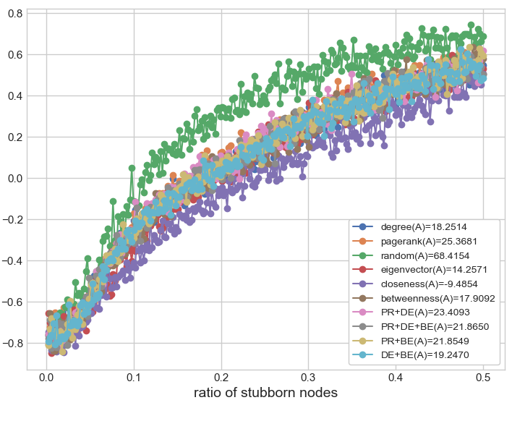
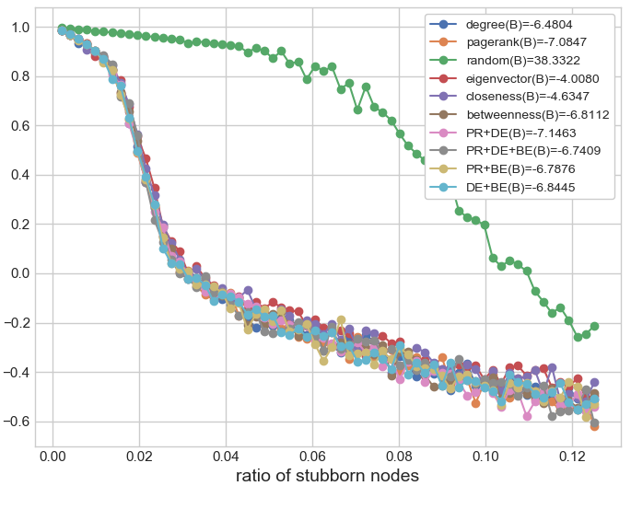
Influences of key nodes on competition
Key nodes on various networks(With different internal edges / BA(2)-BA(4))
② Layer A has a smaller internal degree than layer B
Layer A
Layer B
Rank : random > Pagerank > PR+DE
Rank : PR+DE > Pagerank > DE+BE
Notes:
This is the case that layer A has a smaller internal degree than layer B.
On layer A, the best indicator is random. That means node centrality does not work here.
On layer B, the best indicator is PR+DE.

Slide 45
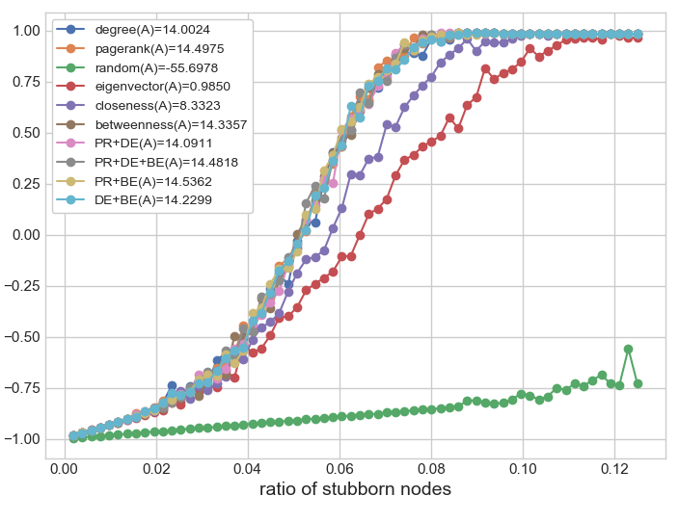
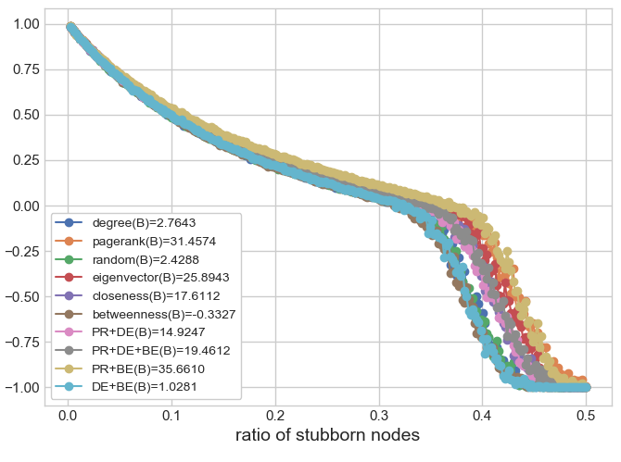
Influences of key nodes on competition
Key nodes on various networks(With different network types / BA(3)-RR(6))
① Layer A type is a BA network, and layer B type is a RR network.
Layer A
Layer B
Rank : PR+BE > Pagerank > PR+DE+BE
Rank : betweenness > DE+BE > random
Notes:
This is the results for selecting key nodes on the two-layer network with different network types.
This is the case that layer A type is a BA network, and layer B type is a RR network.
On layer A, the best indicator is PR+BE.
On layer B, the best indicator is betweenness. However, random indicator is the third rank. That means except for betweenness, node centrality is not working here.

Slide 46
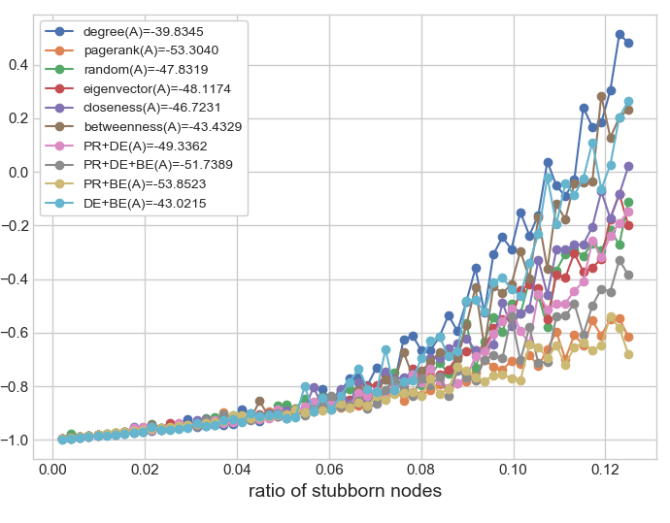
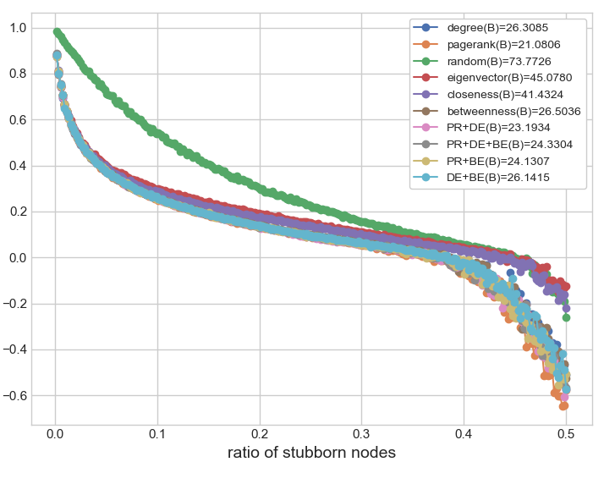
Influences of key nodes on competition
Key nodes on various networks(With different network types / RR(6)-BA(3))
② Layer A type is a RR network, and layer B type is a BA network.
Layer A
Layer B
Rank : degree > DE+BE > betweenness
Rank : Pagerank > PR+DE > PR+BE
Notes:
This is the case that layer A type is a RR network, and layer B type is a BA network.
On layer A, the best indicator is degree centrality. However, random indicator has the middle rank. That means node centrality is not working well.
On layer B, the best indicator is Pagerank.

Slide 47
Influences of key nodes on competition
Total results
Div. | layer | 1st | 2nd | 3rd | remarks
BA(3)-BA(3) | A | PR+BE | PR+DE | PR
 | B | PR | PR+DE | PR+BE
BA(3)-RR(6) | A | PR+BE | PR | PR+DE+BE
 | B | BE | DE+BE | RA | Not working
RR(6)-BA(3) | A | DE | DE+BE | BE | Not working
 | B | PR | PR+DE | PR+BE
BA(4)-BA(2) | A | BE | DE+BE | PR+BE
 | B | PR+DE | PR | PR+DE+BE
BA(2)-BA(4) | A | RA | PR | PR+DE | Not working
 | B | PR+DE | PR | DE+BE
HM(8) | A | PR+DE | PR+BE | PR
 | B | RA | DE+BE | PR+DE+BE | Not working
Notes:
This is the total result of selecting key nodes on various networks.
Every model has the different result. And sometimes, node centrality and combined node centrality are not working well.

Slide 48
Influences of key nodes on competition
Conclusion
- The best and most powerful method for selecting key nodes is different
according to network structures and layers.
- Both single indicator and multiple indicators have an excellent performance for
selecting key nodes. Notably, Pagerank, degree, betweenness and their
combinations have good results.
- There are several situations that the indicators are hard to recognize critical nodes.
① When a network of the selected layer is Random Regular network
② When the number of edges in layer A is small (BA(2)-BA(4))
③ When the number of nodes in layer B is small (Hierarchical Model)
Notes:
Conclusion for the third topic
First, the best and most powerful method for selecting key nodes is different according to network structures and layers.
Second, both single indicator and multiple indicators have an excellent performance for selecting key nodes.
Third, There are several situations that the indicators are hard to recognize critical nodes.
One, When a network of the selected layer is Random Regular network
Two, When the number of edges in layer A is small
Three, When the number of nodes in layer B is small

Slide 49
Summary(1)
A two-layer network model
- The interconnected network with different dynamics on each layer is introduced.
- Many indexes are provided to measure a state of the network and consensus.
* AS, AS total, CI, NCR, PCR, CR
Competition on a two-layer network with various structures
- Network structures are altered by changing internal degree, external degree, and network types.
- An internal degree on each layer has a different function.
* layer A : keeping a positive state and changing a negative state into a positive state
* layer B : hindering a positive consensus state
- Hierarchical Model are provided by changing an external degree on layer B.
HM is easy to make consensus with the state of layer A.
- Too many internal edges on both layers cause coexistence, such as social conflicts.
Notes:
Summary
In chapter2, a two-layer network model is introduced. And many indexes are provided.
In chapter3, we research the competition on a two-layer network with various structures.
Network structures are altered by changing internal degree, external degree, and network types. And we have several results as follows.
- An internal degree on each layer has a different function.
- Hierarchical Model are provided by changing an external degree. It is found that HM is easy to make consensus.
- Moreover, too many internal edges on both layers cause coexistence, such as social conflicts.

Slide 50
Summary(2)
Competition with different updating rules
- Simultaneous updating rule and sequential updating rule are considered according
to where they are applied, such as layer, node, and edge.
- Networks with simultaneous updating rule are easy to make slow-consensus,
coexistence, and transition.
- Networks with sequential updating rules are easy to make fast-consensus.
Influences of key nodes on competition
- To select key nodes on the various networks, single indicators and multiple
indicators are applied.
- The most effective method to select key nodes is different according to network
structures and layers.
- Both single and multiple indicators have an excellent performance to identify critical nodes.
Notes:
In chapter 4, we investigate the competition with different updating rules.
- Simultaneous updating rule and sequential updating rule are considered.
As the results, we find out that networks with simultaneous updating rule are easy to make slow consensus, coexistence, and transition.
Otherwise, networks with sequential updating rules are easy to make fast consensus.
In chapter 5, we study the influences of key nodes on competition
- To select key nodes on the various networks, single indicators and multiple indicators are applied.
As the results, it is shown that the most effective method to select key nodes is different according to network structures and layers.
Moreover, Both single and multiple indicators have an excellent performance to identify critical nodes.

Slide 51
Discussion and Future work
Discussion
- The state of a competition model might be controlled by managing network
structures, updating rules, and key nodes.
- Based on simulation results, the competition models can be applied to
solve social conflicts, such as election, legislation, adoption of new policies,
and so on.
Future work
- Making a generalized competition model with various structures and
updating rules
- Recognizing critical nodes on the generalized competition model
Notes:
Discussion and future work
Discussion
- The state of a competition model might be controlled by managing network structures, updating rules, and key nodes.
- Based on simulation results, the competition models can be applied to solve social conflicts, such as election, legislation, adoption of new policies, and so on.
AS Future work, it is very interesting to make a generalized competition model with various structures and updating rules
Moreover, it is attractive to recognize critical nodes on this generalized competition model.

Slide 52
Thank you
Notes:
Thank you for listening.
I would like to thank my supervisor Professor Wang lin for guiding me.
I would like to thank all the lab mates.

